Slide 1


A Roadmap to Strengthening Families
LINKAGES:
COORDINATED CASE PLANNING
Notes:
Proctor: CACWT check in and attendance.
Trainer Notes:
Trainers introduce themselves, sharing relevant experience related to CalWORKs/Child Welfare/Linkages and their excitement for collaboration to support families.

Slide 2

Welcome!
Getting Started
and Introductions
linkages.cfpic.org

Slide 3

Agenda
Introductions/Group Agreements
Review of Materials
Linkages 2.0, Brief History
Does It Work?
What is Coordinated Case Planning?
The Power of Partnership
Teaming with Families
Local Implementation
Lessons Learned
Wrap-Up: Questions and Discussion
linkages.cfpic.org
Notes:
Purpose: Review the agenda for the day
Trainer Notes: Note breaks, lunch, housekeeping items.
Breakout room for intros next slide.

Slide 4

Introduce Yourself
Name
County
Role
What is your experience
with Linkages?
What keeps you coming back to this work every day?
Notes:
Purpose: Trainees introduce themselves.
Activity: Introductions
Trainer Notes:
Have trainees introduce themselves.
For groups larger than 10, put into breakout groups to introduce themselves.
Virtual delivery: Breakout rooms 5/room, 8 minutes
Paste into chat prior to breakout rooms:
Name
County
Role
What is your experience with Linkages?
What keeps you coming back to this work every day?
Debrief: have participants put in the chat one thing they hope to take away from our time together today.
Transition to group agreements next slide.

Slide 5

Group Agreements
Speak from your own experience
(use “I” statements):
Listen for understanding.
Make space, take space.
Stories stay, learnings leave – mind confidentiality.
We are here, we are human – bring your full presence.
Be willing to experience discomfort individually
and together.
Expect and accept non-closure – multiple realities and experiences can exist and are valid.
What else?
Notes:
Purpose: Establish agreements for the learning space.
Activity: Group Agreements
Trainer Notes:
Explain that these are the standard group agreements developed for use during trainings. Ask if there are other ideas or agreements that participants would like to include in order to create a productive and comfortable learning environment.
Include in the discussion that being intentional about establishing group agreements at the outset of a meeting is a way to set expectations for all participants. Recognizing that we all come from diverse backgrounds, articulating what we can expect from one another during this class can facilitate mutual learning and enhanced understanding. We utilize group agreements in the child and family team meeting process, and reinforcing that practice here is a way for you to become more comfortable with this element of meeting facilitation.
Discuss taking space, making space and multiple ways to join the conversation today (chat, reactions, unmuting, raising hand)

Slide 6

Review of Trainee Materials
Trainee Workbook
linkages.cfpic.org
Notes:
Purpose: To guide participants through the materials we will be referencing during the class.
Trainee Workbook - Includes the agenda, learning objectives, links to handouts and resources, along with information that is designed to serve as a companion to the Powerpoint. Much of the information we will be presenting is included in your Trainee Workbook, affording you the opportunity to pay attention and participate in our discussion without having to worry about taking notes.
Show workbook to the group and orient them to navigating the resources using the clickable table of contents and provide link in the chat: https://ucdavis.box.com/s/96aeps9n9d06gl3lo1vkiaxrt3ikuiuz (be prepared to put the full document into the chat for people who cannot access it in box)

Slide 7
Learning Objectives
Knowledge
K1 – Identify the benefits of collaboration between Child Welfare and CalWORKs in providing comprehensive support to vulnerable families, preventing child abuse and neglect.
K2 – Identify legislation that pertains to Linkages and collaborative work between Child Welfare and CalWORKs.
K3– Identify and analyze the intersection points between CalWORKs and Child Welfare systems to enhance identification of families to improve coordination of services.
Skills
S1 – Apply interdisciplinary collaboration steps in real-work scenarios, integrating planning and assessment processes to optimize outcomes for families.
S2 – Develop an actionable plan for effective collaboration between Child Welfare and CalWORKs which identifies and addresses barriers to collaboration and includes steps to overcome such challenges.
Values
V1 – Appreciate the power of partnership in Coordinated Case Planning, fostering empathy, trust, and mutual respect between professionals and families.
Notes:
Purpose: Identify learning objectives.
Trainer Notes: Review the day’s learning objectives
Virtual: Ask participants to put the number of the learning objective that resonates most with them into the chat.
K1 – Identify the benefits of collaboration between Child Welfare and CalWORKs in providing comprehensive support to vulnerable families.
K2 – Identify legislation that pertains to Linkages and collaborative work between Child Welfare and CalWORKs.
S1 – Identify and analyze the intersection points between CalWORKs and Child Welfare systems to enhance identification of families to improve coordination of services.
S2 – Apply interdisciplinary collaboration steps in real-work scenarios, integrating planning and assessment processes to optimize outcomes for families.
S3 – Develop an actionable plan for effective collaboration between Child Welfare and CalWORKs which identifies and addresses barriers to collaboration and includes steps to overcome such challenges.
V1 – Appreciate the power of partnership in Coordinated Case Planning, fostering empathy, trust, and mutual respect between professionals and families.

Slide 8

What is Linkages?
A brief overview
linkages.cfpic.org
Notes:
Transition to a brief overview of Linkages practice, key legislation, and the Linkages timeline.

Slide 9
Linkages Timeline
CDSS and CWDA continued supporting Linkages as they
saw the benefits of the cross-system collaboration
Linkages 2.0 - CDSS included Linkages in PIP as a way to increase access to services
for children and families
Linkages launched
2000
2011–2014
2018
2006–2011
2014
Federal grant expanded support for Linkages – convenings, newsletters, monthly coordinator calls, and evaluation
Statewide support for
Linkages ended and county participation lagged
Notes:
Purpose: Review timeline of linkages to provide historical context.
Trainer Notes:
Explain that this is a very brief history of Linkages in California. ​
Briefly review timeline and include in the discussion the importance of including Linkages in the statewide PIP and what that means: Consistent support, tracking and monitoring Linkages activities, evaluating effectiveness of this approach.
​
Since 2000, California has worked to develop a dynamic and effective collaboration between child welfare and CalWORKs agencies in order to improve outcomes for children and families in the areas of safety, permanency and well-being.
https://linkages.cfpic.org/detailed-history-of-linkages-in-california/

Slide 10
Legislation Supporting Collaboration
AB 429 – Allows continuation of CalWORKs services for the parent or parents of children who have been removed from the home. If the county determines that services are necessary for Family Reunification (FR), AB 429 provisions allow the parent(s) to receive CalWORKs Welfare-to-Work (WTW) Supportive Services (i.e., WTW plan), substance abuse, and mental health services, if it is determined that such services are necessary for family reunification.
AB 135 – Authorizes the provision of cash aid and childcare services to families participating in CalWORKs Family Reunification (FR) as part of their reunification plan for up to six months.
CalWORKs families receiving FR services now eligible for continued cash aid and childcare services for up to six months (ACL 23-94)
Improved collaborative technology – increased efficiency and improved information sharing
Notes:
Purpose -
To highlight recent legislative changes that support the collaboration between CW and CalWORKs.
Trainer should highlight the fact that these changes reflect a recognition that families receiving FR services need ongoing support from both CW and CalWORKs in order to facilitate successful reunification. Additionally, by providing that support throughout the FR process, we are setting up families for long-term success.
Remind participants that Linkages continues to evolve as legislative changes take place, and as counties identify new strategies that foster success.

Slide 11
Linkages Framework
Primary Prevention Strategies
  Target Population: All Applicants of CalWORKs not involved in CWS to provide support and education before problems occur.
  Linkages Activity: Provide information and materials to promote child and family wellbeing.
Early Intervention/Secondary Prevention Strategies
  Target population: Applicants for/recipients of CalWORKs with identified risk factors/service needs who may/may not have been referred to CWS, but CWS case has not been opened. Families in need of support to alleviate identified problems and prevent escalation. (Hotline/ER/Family Stabilization/Home visiting/Differential Response)
  Linkages Activity: Align and coordinate early intervention services and supports.
Mutual Client Coordination/Tertiary Prevention Stategies
  Target Population: Families who are open to CalWORKs and CWS. (Family Maintenance, Family Reunification)
  Linkages Activity: Provide interventions for children experiencing maltreatment. Coordinate joint services, supports and resources to prevent re-entry to CWS and alleviate economic stressors.
Notes:
Purpose: Describing collaborative efforts of CWS and CalWORKs in each stage
Trainer Notes:
Briefly describe the levels of intervention on the slide.
Our class today will be focusing on the tertiary level of intervention. While Linkages has historically focused on enhancing mutual client coordination, Linkages 2.0 includes an emphasis on family-focused case planning and goal-oriented service delivery. Both CW and CalWORKs have undergone significant practice reforms and Linkages 2.0 includes elements of CW’s CPM and CalWORKs 2.0.
Uplift the following:
Linkages Primary Prevention
CalWORKs as an important program to strengthen family and child wellbeing
Resource material to be shared with families when applying for grants
Linkages Secondary Prevention
Collaboration that supports early intervention with families with risk factors to prevent CWS referral
Family Stabilization
Home Visiting
Collaboration that supports families that have been referred to CWS from becoming a case
Differential Response
Emergency response coordination with CalWORKs for supportive services
Linkages Tertiary Prevention
Family Maintenance – Collaboration between CWS workers and CalWORKs case managers (WTW, FS)
Family Reunification – Child in foster care but CalWORKs Services & grant continued (AB 429 and AB 135)
Aftercare – Child returned to family with expedited connection to CalWORKs if eligible
TAY- Transitional Age Youth
Questions for trainers to ask participants:
How might counties support connecting mutual families to linkages services?

Slide 12

Key Components of Coordinated Case Planning
linkages.cfpic.org
Notes:
Transition to a brief overview of Linkages practice, key legislation.

Slide 13
What is Coordinated Case Planning (CCP)?
Working together toward child safety, family stabilization /
well-being, & self-sufficiency
Streamlined services
Coordinated resources to maximize family’s goals:
  AB 429 and AB 135 - Continuation of
  CalWORKs support for families whose children
  have been placed in out-of-home care
  Behavioral health and substance use
  disorder services
  Homeless services
  Family stabilization
  Home visiting
  Consistent communication over life of case
Notes:
Purpose: Define Coordinated Case Planning. - AB 429 and AB 135
Trainer Notes:
Families are engaged through a variety of joint meetings, services and communications. Staff from both CalWORKs and CWS work together toward the same goal—ensuring child safety while promoting family economic stability.
When families fall under ICWA, it is imperative to bring the tribe to the table as you are coordinating services, ensuring access to culturally relevant services and supports and including the tribe in decisions regarding the safety and wellbeing of the children.
Relevant ACL's:
CDSS All County Letter (ACL) 02-36 https://www.cdss.ca.gov/lettersnotices/entres/getinfo/acl02/pdf/02-36.pdf references AB 429
CDSS All County Letter 21-150 https://www.cdss.ca.gov/Portals/9/Additional-Resources/Letters-and-Notices/ACLs/2021/21-150.pdf?ver=2021-12-30-113041-027 references AB 135
CDSS All Count Letter 21-140 https://www.cdss.ca.gov/Portals/9/Additional-Resources/Letters-and-Notices/ACLs/2021/21-140.pdf?ver=2021-11-19-153428-340 references AB 135
CDSS All County Letter 21-131 https://www.cdss.ca.gov/Portals/9/Additional-Resources/Letters-and-Notices/ACLs/2021/21-131.pdf?ver=2021-10-27-084034-477 references AB 135
CDSS All County Letter 21-85 https://www.cdss.ca.gov/Portals/9/Additional-Resources/Letters-and-Notices/ACLs/2021/21-85.pdf?ver=2021-08-11-164455-037 references AB 135

Slide 14
Guiding Principles
Core Practice Model
CalWORKs 2.0
Strengthening Families
Equity and Inclusion
Notes:
Purpose: Transition into discussion of concepts and principles guiding development and implementation of Linkages 2.0.
Trainer Notes:
Mention to participants that we will be discussing the principles that define how we want to work with families. All of these principles share the value of collaboration, strength-based practice and the importance of listening to what families have to say about their strengths and about what they need. This values the voice and choice of the family and promotes success as they are empowered to become part of the process in their own wellbeing.

Slide 15

Core Practice Model (CPM)
What Does It Look Like?
Practice Behaviors
  Engagement
  Inquiry and Exploration
  Teaming
Notes:
Purpose: To define and provide examples of specific CPM behaviors, emphasizing those related to Inquiry and Exploration as well as Teaming.​
​
Trainer can refer participants to the CPM Framework Brochure in the Supplemental Handouts​
​
Trainer Notes:​
The Core Practice Model includes specific behaviors, including Engagement, Inquiry and Exploration, and Teaming, that are associated with each component, both for direct practitioners and for leadership. By outlining clear expectations for all levels of staff, agencies are conveying their commitment to full implementation of CPM. For our discussion today, we are going to focus on some key behaviors that support successful Linkages partnerships.​
Engagement: The range of activities, behaviors, and interactions between helping professionals and the children and families they serve that create an effective working alliance and shared responsibility for change.
What does engagement look like in practice?
Demonstrate an interest in connecting with the family and helping them identify and meet their goals by actively listening; and acknowledging what is important to them.
Reflect what you heard and use language and concepts the family has used to show that you understood.
Identify and engage family members, natural supports, and others who are important to the family, making a special effort to engage fathers and paternal relatives.
Show cultural humility and use language and body language that demonstrate an accepting and affirming approach to understanding the family, their experiences, and their culture.
Show respect for Tribal sovereignty and deference to Tribal leadership and their titles.
Ask people how they prefer to be addressed, and address individuals by the name or title and pronouns they request in person and in writing.
Ask family members what method of communication they prefer, use age-appropriate language that everyone can understand, and confirm with family members that your communication meets their language and literacy needs.
Help family members access the services and supports in their language that meet their individual needs and ask for feedback about their experience with the services and supports they receive.
Sustain and renew engagement efforts by reaching out regularly, sharing information, and responding to evolving family needs with culturally relevant services and supports.
Inquiry and Exploration: Seeking feedback to understand the family’s perspectives to develop consensus, and create a path forward that is sensitive to the varied needs and concerns of all parties.
What does Exploration look like in practice?
Inquire about a family’s culture, values and beliefs and incorporate them throughout your work with the family.
Work continuously to find, locate, and learn about family members, Tribal connections, and supportive relationships.
Ask about and acknowledge the trauma experienced by the family including the traumatic impact of involvement in the child welfare system.
Explore the expressed and underlying needs of the family by asking about their experiences and identifying their strengths, needs, safety concerns, and solutions.
Ask family members about their ideas about safety and permanency and incorporate their perspectives in all practice.
Ask children, youth, and young adults about their worries, wishes, where they feel safe and where they want to stay and incorporate their perspectives in practice.
Teaming: The team building process begins with the initial interactions between the child welfare worker and the child, youth, and family. From the initial conversations, engagement is critical. By eliciting the family’s story, the worker can begin to understand the child, youth, and family member’s strengths, self-identified needs, culture, natural supports, and vision for the future.
What does Teaming look like in practice?​
Partner with the family to build and sustain a team of natural and professional supports that engages and centers the family and their cultural, community and Tribal connections as early as possible.
Facilitate development of a mutually supportive relationship between the parents and caregivers.
Promote the capacity of family members, Tribes, and their teams to identify culturally responsive services, supports, visitation activities, and meeting locations that honor family members’ traditions and needs.
Facilitate culturally responsive team processes, utilizing available and relevant assessments to make decisions in partnership with the family and their team.
Be transparent about the role of the court and the child welfare agency and constraints that may limit shared decision-making.
Collaborate with the family and their team to recognize and respond to evolving family needs.
​
​
**Refer participants to workbook for more information on the CPM.

Slide 16
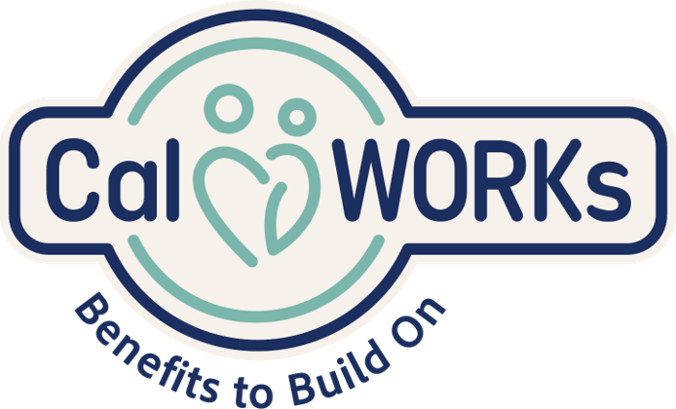
CalWORKs 2.0
Teaming
Engagement
Coordination
Brokering
Outreach
Notes:
Purpose: Review of CalWORKs 2.0 basic concepts.​
​
Trainer Notes:​
CalWORKs 2.0 promotes goal achievement for the family and is driven by tools developed to identify and support unique family needs. ​
CalWORKs staff complete appraisals and engage the family in motivational interviewing to provide meaningful support to families based on their voice and choice. ​
CalWORKs 2.0 seeks to promote family stability with the recognition that first prioritizing the family’s stability enables other pieces – such as education, employment, and family wellness – to fall into place. CalWORKs staff also support brokering relationships with community partners and connections to resources in support of the family’s goals for wellness and self-sufficiency.​
Ask participants: what are some of the services available under CalWORKs 2.0 that go beyond employment to support family stability?​
​
Examples to share if not uplifted (do not share all):​
Examples of Activities to Remove Barriers & Promote Family Well-Being​
Behavioral Health Referrals ​
(Child and Adult)​
Substance Use Disorder (SUD) Programs & Supports​
Domestic or Familial Violence Counseling, Supports​
Anger Management Classes​
Examples of Supportive Services​
Child Care​
Transportation​
Books & Supplies for School​
Diaper Assistance​
Uniforms​
Tools and Supplies​
Clothing to support Job Interviews​
Resume support​
Interview Skills and Coaching​
Examples of Educational or Employment Activities:​
English as a Second Language (ESL) Programs​
College Degree Programs​
Certificate Programs​
Vocational Training, Job Skills Training​
Work Study, On the Job Training​
Job Retention Services​
​
**refer participants to workbook for additional information on CalWORKs 2.0 for later reference.​
Source: https://www.cwda.org/sites/main/files/file-attachments/day_1_b1_s5_calworks_2.0_road_tests_implementation_insights_and_county_experiences_0.pdf?1511906326

Slide 17
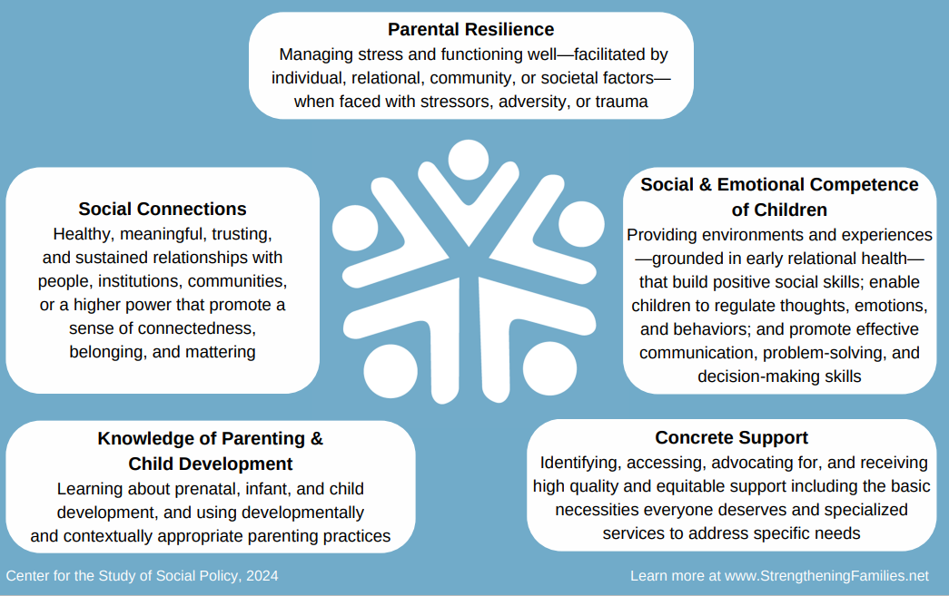
Strengthening Families Protective Factors
Notes:
Purpose: Review protective factors in the context of supporting collaborative work with families.
The Strengthening Families initiative is a comprehensive, strengths-based approach that identifies specific factors that support child and family well-being. It recognizes that many families have the potential for positive change and that children often benefit from maintaining strong connections with their families whenever possible. This approach also aligns with the Core Practice Model and CalWORKs 2.0 practice model.
Trainer Notes:
Briefly review each of the five factors through use of examples provided below. Trainee Workbook has definitions and examples of each for reference and additional information.
Parental resilience:
Example: Mom is a newly single parent and expects her seasonal employment to end next month. She knows this will be a challenge, and has reached out to her CalWORKs worker for support with job placement and interview skills.
Social connections:
Example: Parents of a child with special needs are connected to a play group and make connections with other parents who are caring for a child with special needs. This helps broaden their support network.
Knowledge of parenting and child development:
Example: A Social Worker helps Dad learn to respond in a positive way when his child misbehaves – instead of yelling at his child, he learns to help the child regulate their emotions by having them practice taking slow, deep breaths.
Concrete supports in times of need:
Example: The family reaches out about a 48-hour shut off notice for their utilities. The Social worker connects the family with the Low-Income Heating and Energy Assistance Program (LIHEAP) to get help paying their overdue bill; this prevents the family’s lights from being shut off.
Social and emotional competence of children:
Example: Mom and Dad create a regular family check-in routine with their children to talk about their day.
What we know: Families gain what they need to be successful when key protective factors are robust in their lives and communities

Slide 18

Collaboration
Linkages and Child Welfare
linkages.cfpic.org
Notes:
Transition to collaboration.

Slide 19

Collaboration is an Action!
“People support what they
have had a hand in creating.”
– Margaret Wheatley
Notes:
Purpose: To explain the importance of collaborating with families in assessments and decision making.
Suggested language:
Traditionally in social work and child welfare, assessment was seen as a fully professional activity. We study something—or someone—and gather and analyze information and told the clients what they needed to do.
In a truly collaborative partnership, the perspective and input of families, children, and youth are equally important, if not more, than our perspective. They are the experts on their lives and their family.
If you were working with a child welfare professional (or any other helper), would you want the assessment to be done to you? You might want the helper’s expertise, but you would also want to be an equal participant so that your perspective is understood and any goal setting and decision making included your input on what would work for you.
We call this "assessment with" instead of just "assessment of."
Organizational theorist Margaret Wheatley captures this neatly with this quote: “People support what they have had a hand in creating.”
The Core Practice Model (CPM), Child and Family Teaming, Child and Adolescent Needs Assessment, Wraparound, and Safety Organized Practice all support engaging with families in this collaborative partnership.

Slide 20
Collaborate for Success
Aligns case plan goals.
Streamlined access to service.
Leverage resources from both child welfare and CalWORKs.
Reduced duplication of service referrals and resources.
Faster/easier access to needed services.
Addresses child safety as well family self-sufficiency.
Considers work readiness or what supports may be
required based on the parent’s needs and ability to work.
Ensures families receive a wide range of support services,
addressing both their financial needs and the safety
and well-being of their children.
Notes:
Purpose: Identify the benefits of collaboration.
Trainer Notes:
Linkages has already demonstrated the benefits of cross-sector collaboration. By coordinating case plan activities for a family, we can more effectively serve the families we have in common by:
Reducing number of meetings/appointments for families
Coordinating required case plan activities to reduce duplication of service referrals and supportive services (e.g., mental health and domestic violence services).
Leveraging resources and staff strengths from both programs.
Providing opportunity to use information known by the Child Welfare caseworker to support case plan goals.
It can also help us to determine what support may be needed for parents to become work ready, such as obtaining a GED, attending college, work experience, skill building or resume support – while considering other paths for parents who may be unable to work due to a disabling condition (emotional or physical). In example, help applying for disability benefits.
Collaboration creates a team approach to working with vulnerable families allowing us to align services and better support families wholistically.

Slide 21

Small Group Activity
What’s required for successful collaboration between CalWORKs
and Child Welfare ?
linkages.cfpic.org
Notes:
Purpose: Explore what is needed for successful collaboration between CalWORKs and Child Welfare.
Activity: Small group activity - Group Brainstorm (15 minutes)
Alternative activity: WordCloud /Zoom whiteboard- if time is limited, this activity can be done by having participants reply to the prompts on zoom whiteboard, in a large group discussion, or by using Mentimeter.
In-person Delivery: Have participants form table groups of 4-6 people, depending on group size.
Virtual Delivery: Set up breakout rooms for teams of 4-6 people, depending on group size.
Allow 8 minutes for breakout discussion, then return for debrief and large group discussion, seeking feedback from both Child Welfare and CalWORKs trainees. (5-7 minutes)
Ask Participants:
What is required for successful collaboration between Child Welfare and CalWORKs?
What barriers might there be?
How could those challenges be addressed?
Trainer Notes:
Remind group of group agreements, where we discussed listening for understanding, speaking from your own experience, using a both/and framework, etc.
For county-specific trainings, explore what challenges have come up and brainstorm what solutions may support better collaborative work. What needs to happen?

Slide 22
What Does Collaboration Look Like?
Agency Level | Practice Level
Policies and procedures reflect commitment to Linkages | Identify Linkages families as soon as possible upon case opening (Best practice is identification when referral is received.)
Co-location of staff | CalWORKs staff participates in CW case consultation/staffing.
Linkages implementation teams | CalWORKs staff attends and participates in CW child and family team meetings (CFTM’s).
Joint trainings | Develop case plan through CFTM process that includes CalWORKs requirements.
Highlight successes | Meet with family members as required.
Identify practice champions | Participate in ongoing CFTMs and monitor family’s progress.
Notes:
Purpose: To illustrate the specific behaviors and practices at both the agency and individual practice levels that reinforce effective collaboration. (IDEALLY BEFORE THE ER WORKER GOES OUT)
Trainer Notes:
Review the slide, highlighting the importance of collaboration at both the agency level and the practice level. Linkages is likely to be more successful when agencies develop the infrastructure to support the collaboration and also communicate through the development of policies and procedures the expectation that this partnership represents a baseline – it’s not an ”extra” service we provide. Rather, it is the way we – as child- and family-serving agencies – support our families.
Highlight joint trainings as an opportunity for enhanced collaboration. In addition to Linkages-specific training, creating opportunities for CalWORKs and CW staff to attend additional in-service trainings can foster shared understanding. For instance, CalWORKs staff recently attended Safety-Organized Practice training in some counties, which has traditionally been a child welfare-specific curriculum. By participating in this training, CalWORKs staff not only increase their knowledge base, they also have a richer understanding of the principles that guide CW decision-making.
When agencies commit to full implementation, the slide describes some of the practices we would expect and hope to see.
Ask participants if they can think of additional collaborative activities at either the agency or practice level.
For county-specific trainings, this may be a good time to identify what collaboration has looked like or could look like in your county.
On a scale of 1-10, how have you done with each of these Agency and Practice-Level areas?
What would be needed to move up one to two notches on the scale toward best practices in collaborating?
**Refer participants to trainee workbook for additional information regarding collaboration.

Slide 23

Teaming
Supporting Mutual Families
linkages.cfpic.org
Notes:
Purpose: Transition to discussing teaming.

Slide 24

Phil Jackson – Los Angeles Lakers:
“The strength
of the team is each individual member. The strength of each member is
the team.”
Notes:
Trainer Notes:
Make the point that, while we can establish policies and protocols that create the expectation of collaboration, it takes a commitment to work together as a team to achieve the positive outcomes we are looking for.
Lift up the importance of effective teaming as colleagues in order to better serve families. Through mutual respect for each participant’s unique contribution, we can come together to provide families with a springboard to success.

Slide 25
Team Development
Clear definition of roles/expectations​
Shared goals​
Team members’ individual contributions are respected and encouraged​
Team communication is clear and proactive​
Team members are accountable​
Disagreements/conflicts are addressed​
Notes:
Purpose: Identify key components of effective teaming.
Trainer Notes:
Now that we have an idea of what is required to collaborate effectively, let’s consider the behaviors that are required for effective teamwork. Remind participants that while we may have prior experiences, ideas and practice being part of a team, there are very specific behaviors that facilitate effective teaming. Review each of the bulleted points on the slide.
There is additional information about effective Linkages teaming in the trainee workbook for your reference.

Slide 26
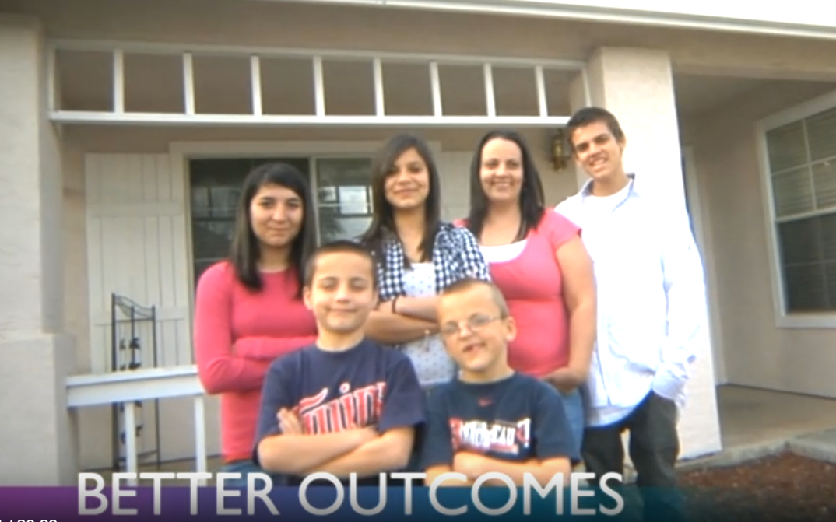
Meeting the Linkages Challenge
Video to come
Notes:
Purpose: Provide participants with real-life examples of how Linkages can work to support families.
Trainer Notes:
Show video, Meeting the Linkages Challenge: https://linkages.cfpic.org/wp-content/uploads/linkages1.mp4
Remind participants that one of the questions we identified in our agenda this morning was “Does it work?” Let them know that this video is a great example of exactly how Linkages can work to empower families and enhance child and family well-being.
Start video at 4:30 and watch through to the end.
Debrief: Guide a discussion about the video.
*in larger groups, breakout groups could be helpful.
Ask participants:
What stood out?
In what ways did Linkages support the family members depicted in the video?

Slide 27
Activity – Case Vignette: Collaboration in Action
The Carillo Family: Mom, Dad, and two children, ages 4 and 7
How might CalWORKs and CWS team to support this family?​
What services might be helpful and how will these services enhance the parental protective factors and child safety?​
Linkages Coordinated Case Planning Trainee Workbook
Vignette Activity: Collaboration in Action Pages 18-19
Notes:
Purpose: Practice identification of areas in which teaming can support families.
Activity: Small Group Activity
Table groups/Breakout rooms of 5-6 participants, 15 minutes in their group to discuss followed by large group discussion.
Trainer Notes:
Read the Carrillo Family scenario and discuss questions:
**refer participants to their Coordinated Case Planning workbook read vignette and make notes.
Vignette: (pages 18-19 in trainee workbook)
Scenario
The Carillo family, Mom, Dad, and two children ages 4 and 7, became involved with Child Welfare due to child neglect concerns as the children were left unsupervised for an extended period of time.
Background
The family is receiving CalWORKs as Dad recently lost his job, and Mom works part-time as a hotel receptionist. They are having difficulty paying rent and household expenses. Mom is struggling with depression, and the stress of their situation has caused some tension with Mom and Dad’s relationship. Mom and Dad lack access to support systems such as family, neighbors, and community who could provide assistance with childcare. With limited resources, the parents have been unable to afford childcare. This leads to situations where the children are left unsupervised while Dad seeks employment and Mom goes to work.
Child Welfare Services Involvement
A concerned neighbor made a report that the children had been unsupervised in the home for extended periods of time. She was also concerned they did not have food, asthey knocked on her door to ask for something to eat. Upon investigation, the responding Social Worker found the following additional concerns:
Unsafe Living Conditions: The home was found to be in a state of disrepair, with exposed electrical wiring, broken windows, and a lack of basic sanitation. There was also evidence of pest infestation.
Lack of Basic Necessities: The children were found without adequate clothing, and the home lacked sufficient food. The refrigerator was nearly empty.
Health and Hygiene Issues: The children appeared unkempt and had not bathed in several days. Given these findings, the allegations of neglect were substantiated, and the children were removed from the home for their safety, with reunification services offered to both parents.
Collaboration in Action
Mom and Dad now have an active Child Welfare Family Reunification case and will benefit from a Linkages approach, as they were active with CalWORKs at the time of detention. CWS conducted a comprehensive assessment and recognized the overlapping needs of the Carillo family, including housing instability and lack of childcare, which could be offered by CalWORKs. The social worker initiated a referral to CalWORKs, highlighting the family’s situation and potential CalWORKs needs. The referral was communicated to the CalWORKs case manager, who promptly reached out to the social worker to discuss the family’s case and explore opportunities for collaboration.
1. How does a Linkages approach support this family?
2. How might CalWORKs and CWS initiate teaming to support this family?
3. What services might be helpful and how will these services enhance the parental protective factors and child safety?
4. Are there similar situations in your county where this approach has worked or may work well?

Slide 28

Assessments and Coordinated
Case Planning
linkages.cfpic.org
Notes:
Transition to Assessments and Coordinated Case Planning.

Slide 29
Child and Family Assessments
Agencies use a wide variety of different tools in their efforts to understand what families need to reduce risk of child maltreatment and to enhance safety and well-being:
Safety Organized Practice (SOP)
Child Welfare Structured Decision Making (SDM)
Child and Adolescent Needs
and Strengths (CANS)
On-Line CalWORKs Appraisal
Tool (OCAT)
County-specific assessment tools
Notes:
Purpose: Provide a brief overview of the multiple types of assessments used in our work with families.
Trainer Notes:
Safety Organized Practice – SOP – Safety Organized Practice (SOP) in child welfare is an approach that prioritizes the safety and well-being of children and families involved in the child welfare system. It focuses on collaborative and strengths-based strategies to enhance child safety while respecting family needs. SOP requires that we conduct a rigorous and balanced assessment with the family – it is not something we do “to” the family. Through the use of techniques that facilitate family engagement, we are better able to not only identify family strengths but also to utilize those strengths and natural supports to mitigate risk and enhance safety.
Child Welfare Structured Decision Making (SDM)- is a suite of research-based assessment tools that are designed to assist child welfare staff at critical decision points throughout the life of a child abuse/neglect case.
Child and Adolescent Needs and Strengths (CANS)- The CANS is a multi-purpose tool that supports decision-making, including level of care and service planning, which allows for the monitoring and outcome of services. When used as part of the CFT process, as California is doing, the CANS Assessment can help guide conversations among CFT members about the well-being of children and youth, identify their strengths and needs, inform and support care coordination, aid in case planning activities, and inform decisions about placement.
On-Line CalWORKs Appraisal Tool (OCAT)- The OCAT is a web-based interview tool designed to equip CalWORKs caseworkers with an in-depth appraisal of client strengths and barriers to self-sufficiency. The tool gathers and provides information about the client on a variety of topics, including employment and educational history, housing stability, physical and behavioral health, and domestic abuse, in order to assist caseworkers in developing effective welfare-to-work plans. ACL 15-69: Questions And Answers Regarding The CalWORKs WTW Program Appraisal And The OCAT
Refer participants to workbook for additional information regarding assessments to reference later.
Ask participants:
Are there any other assessment tools utilized in your counties regularly in your work with families?
What benefit do you see in sharing information gathered in these assessments with your partner agency?
What challenges might come up in sharing this information?

Slide 30

Child & Family Assessments
Both CW and CalWORKs use a multitude of assessments that really seek to answer these questions:
What’s working well?
What are we worried about?
What needs to happen next?
Notes:
Purpose: Introduce the "three questions" approach to working with families.
Trainer Notes:
When we are working with families, using this simple three-step framework can facilitate open and direct communication. This structure can facilitate communication with family members, as it encourages family-friendly language. We often refer to this as a Safety Map and it forms the foundation of our case plan.
What’s working well?
This is an opportunity to highlight a family’s strengths. In addition to asking family members directly what is working well, team members should also use the information from the various assessment tools that have been completed.
For example, if a family has stable housing, that information would be included in this column. Another example might be a parent’s acknowledgment that they need and are ready to participate in services.
What are we worried about?
This step is when the agency team member(s) discuss the reasons for CW involvement.
For example “We’re here because Baby Doe was born tox positive. We’re worried that your drug use will further harm Baby Doe.”
By asking family members what they are worried about, team members will have an opportunity to assess a family’s readiness to engage in the case planning process.
If there is a discrepancy between the parents’ perception and the agency’s perception, that is an additional factor to consider in developing a case plan.
What needs to happen next?
This step is where the case plan is developed. It is important to include in this step specific tasks, due dates and responsible parties in order to ensure accountability for the plan. For instance:
CW worker to provide referrals for substance use treatment by_____
CalWORKs worker to determine eligibility for transportation assistance by_____
Parent to complete intake at substance use treatment within 5 days of receiving information from CW worker.
CW worker to provide caregiver with referrals for Early Start provider for Baby Doe
Caregiver to confirm intake for Early Start within 5 days of receipt of information from CW.
The meeting should also include discussion of the next meeting date and expectations for how information will be shared prior to the next meeting – via text message, phone or email – this will depend on the individual family’s situation as well as county policy

Slide 31
Coordinated Case Planning: What Happens Next?
Three-way partnership between the family,
Child Welfare and CalWORKs
Regular Child and Family Team meetings
Sharing of resources
  Court-ordered case plan
  CalWORKs participation requirements
Notes:
Trainer Notes:
Through completion of the SDM, the CANS, the CalWORKs appraisals/assessments, and with the input of the family members at a CFT meeting, the team can formulate the coordinated case plan. Ideally, this plan reflects the three-way partnership that is the foundation for Linkages: the family, CWS and CalWORKs. If someone holds the coordinated plan up, all three should say, “This is our plan.”
Some counties may have two separate, but aligned and jointly developed plans. Other counties may choose to have one coordinated case plan. The important thing is the alignment and leveraging of services and collaborative support of families.
A best practice is to invite the CalWORKs case manager to the Child and Family Team Meetings, which should convene at least every 6 month to monitor the plan and identify additional support needed. The purpose of these CFTMs is to discuss successes, challenges or obstacles that come up and brainstorm ways to move forward. The CFTMs are the vehicle by which case plans are revised and/or updated. A family’s circumstances can change significantly in a relatively short period of time, and their case plan must be updated to reflect those changes. For example, if a family is moving towards reunification but requires housing support, addressing the need in the CFTM can potentially reduce any delays and therefore facilitate more timely reunification.
An essential element of coordinated case planning is the sharing of resources. CalWORKs/welfare-to-work supportive services are available to assist child welfare families access childcare, transportation, job training or secondary education as well as behavioral health or substance use disorder treatment services. In addition, the activities required in the child welfare case plan can often count toward work participation requirements in CalWORKs. Intentional teaming and planning helps promote success through preventing a duplication of efforts. In example, the parent is not being asked to attend a CalWORKs required activity at the same time their CW Social Worker has planned for a required parenting class.
The Three Columns tool is something that can be used at every CFTM to ensure a shared understanding of the families’ strengths and challenges and what concrete steps are needed to progress.

Slide 32
Coordinated Case Planning: Monitoring and Adapting
Maintain between-meeting communication via text/email/phone
Ensure required reassessments take place in accordance with county/agency policies
Transition planning
Notes:
Purpose: Continue discussion of practical application of coordinated case planning activities.
Trainer Notes:
Earlier in the day, we discussed elements of successful collaboration along with characteristics of effective teams: Clear expectations, respect for all team members’ contributions and holding members accountable for their commitments.
By holding folks accountable, we are agreeing to fulfill our responsibilities in accordance with policies, procedures and the families’ unique situation. In order to provide services and interventions to families that are relevant to them, that address their needs timely, the team will need to establish expectations for between-meeting communications.
Court timelines and CalWORKs participation timelines often create a sense of urgency for the family as well as for staff. To maximize efficiency, team members should maintain communication between CFTMs so that any significant changes/updates can be addressed and the plan can be revised prior to the next CFTM. While CFTMs can be convened as frequently as the family circumstances dictate, oftentimes a a phone call or email can serve to communicate the necessary information.
Both CW and CalWORKs are required to complete periodic reassessments to determine the family’s current functioning. To maximize the use of the CFTM time, team members are encouraged to complete all required reassessments prior to the CFTM so that information can be shared during the meeting. This will ensure that all meeting participants have been provided with the most updated information possible.
Through coordinated case planning, notification of key milestones in the life of the case becomes a natural part of ongoing communication. One of these milestones is when the family’s involvement in either their child welfare case or their CalWORKs case is about to end.
Closure activities for a family involved with Linkages include transition planning related to how after care or follow-on support needs can best be met. This is where strategies used in the primary and secondary prevention levels of Linkages may again be relevant.
Connecting families to community-based supports, information and resources that build their parenting skills and promote the protective capacity of their family can help keep children safe and families stable in the months and years ahead.
Ask participants:
How do you coordinate case plans between CWS and CalWORKs?
If this is new to your county, what do you think would be the best way to do this?

Slide 33
Breakout Activity: Vignette Collaborative Approach
Breakout Group Discussion
Refer to the Vignette in your workbook and discuss:
What would CalWORKs and CWS be doing to facilitate communication and the coordination of services?
What would CalWORKs need from Child Welfare?
What would Child Welfare need from CalWORKs?
Notes:
Purpose: Practice identification of areas in which teaming can support families.
Activity: Small group discussion, table groups or break out rooms of 5-6 participants. 15 min.
Instructions:
Read vignette on page 20 of their CCP Trainee Workbook, and discuss:
What would CalWORKs and CWS be doing to facilitate communication and the coordination of services?
What would CalWORKs need from Child Welfare?
What would Child Welfare need from CalWORKs?
**refer participants to their workbook for the vignette and to make notes.
Have participants share when they return to the main room/group.
Activity: Vignette- Collaborative Approach
CalWORKs Support
CalWORKs was able to provide immediate rental assistance to prevent eviction and ensure housing stability. Mom and Dad were offered employment support services including resume assistance, job search resources, referrals to potential employers, and childcare to assist during job search/work.
Teaming for Supportive Services
The CWS social worker identified that the family is both active with CalWORKs and CWS involvement.
Collaborative Approach
Both CalWORKs and CWS collaborated closely to coordinate services and support for the Carillo family. Joint meetings were held to discuss the family’s case, share information, and develop a comprehensive service plan tailored to the family’s unique needs, strengths, and circumstances. By leveraging the skills and strengths of both CWS & CalWORKs and the resources of both agencies, the family received integrated support that addressed their immediate needs and promoted their long-term stability.

Slide 34
Lessons Learned: What Works?
Support from Leadership
Co-location when/where possible
Implementation teams
Infographic/
other materials depicting Linkages workflow
Cross-training ALL staff
Highlight successes
Notes:
Purpose: Participants commit to at least one action they can take in order to support Linkages.
Trainer Notes:
Spend a few minutes highlighting the lessons learned on the slide to prepare participants for the Linkages in Action whiteboard activity next slide.

Slide 35

Whiteboard Activity
Write down one thing you need to do to coordinate with the child welfare social worker/WTW case manager when working with a mutual family.
Notes:
Purpose: Participants commit to at least one action they can take in order to support Linkages.
Activity: Linkages in Action Whiteboard Activity (15 minutes)
Instructions: On page 21 of your Linkages Coordinated Case Planning Trainee Workbook, write down one thing you need to do to coordinate with the child welfare social worker/WTW case manager on a case where there is a mutual family in your county.
After giving participants a few minutes to write down their commitment in their workbook, ask participants to share with the larger group. This can be done verbally, in the chat, or on the whiteboard depending on time.
Virtual delivery: show participants how to use white board to add a sticky note with their response)
For in-person delivery, utilize chart paper or have participants share out loud.
Trainer Notes:
Spend a few minutes highlighting the comments on the White Board or sharing out in the larger group.
Remind participants that even if their local county has not yet implemented Linkages, they still can commit to an action that will support cross-program collaboration.
Refer participants to trainee workbook to make notes during the activity in the action plan section. Remind them that there is additional information intended to serve as a resource to them for later reference within their workbook.
Share:
https://cfpic.org/initial-linkages-evaluation-results-families-share-their-perspective/

Slide 36

Questions & Comments
linkages.cfpic.org

Slide 37

Feedback
What worked well?
What could we do better??
Notes:
Trainer Notes:
Guide participants through a feedback dialogue regarding what worked well for them and anything they feel could be improved with the training.

Slide 38
References
CDSS programs. Home. (n.d.). https://www.cdss.ca.gov/inforesources/cdss-programs/foster-care/healthy-sexual-development-project/expectant-parent-and-parenting-support-hub#HRC – 12/7/23
Cyndi. (2021, July 5). Homelessness. NFYI. https://nfyi.org/issues/homelessness/
Detailed history of linkages in California. The Linkages Project. (2022, April 14). https://linkages.cfpic.org/detailed-history-of-linkages-in-california/
Experience. (n.d.). https://experience.arcgis.com/experience/7227e954a08a4d2cb990949aa029275d/page/Dashboard/ - 12/7/23
Feng, H., Harty, J., Okpych, N. J., & Courtney, M. E. (2020). Memo from CalYOUTH: Predictors of homelessness at age 21. Chicago, IL: Chapin Hall at the University of Chicago.
Home. The Linkages Project. (2024, January 23). https://linkages.cfpic.org/
Https://www.cdss.ca.gov/portals/9/additional-resou... (n.d.-a). https://www.cdss.ca.gov/Portals/9/Additional-Resources/Forms-and-Brochures/2020/I-L/LIC9274.pdf?ver=2022-02-22-163616-390
Insights from the CalWORKs 2.0 road tests. (n.d.-b). https://www.cwda.org/sites/main/files/file-attachments/day_1_b1_s5_calworks_2.0_road_tests_implementation_insights_and_county_experiences_0.pdf

